Slide 1
Sequence Diagrams

Slide 2
Interaction Diagrams
UML Specifies a number of interaction diagrams to model dynamic aspects of the system
Dynamic aspects of the system
  Messages moving among objects/classes
  Flow of control among objects
  Sequences of events

Slide 3
Dynamic Diagram Types
Interaction Diagrams - Set of objects or roles and the messages that can be passed among them.
  Sequence Diagrams - emphasize time ordering
  Communication Diagrams - emphasize structural ordering
State Diagrams
  State machine consisting of states, transitions, events and activities of an object
Activity & Swimlane Diagrams
  Emphasize and show flow of control among objects

Slide 4
Sequence Diagrams
Describe the flow of messages, events, actions between objects
Show concurrent processes and activations
Show time sequences that are not easily depicted in other diagrams
Typically used during analysis and design to document and understand the logical flow of your system
Emphasis on time ordering!

Slide 5
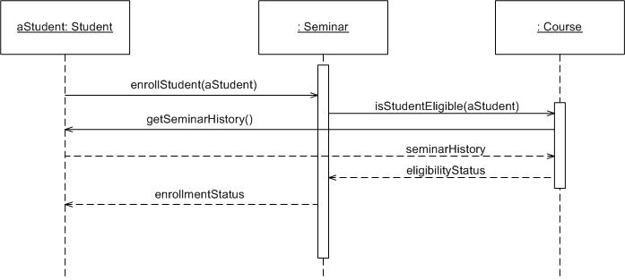
Sequence Diagram
Coming up: Components

Slide 6

Sequence Diagram
Time Increasing -->
All lines should be horizontal to indicate instantaneous actions. Additionally if ActivityA happens before ActivityB, ActivityA must be above activity A
Lower = Later!
Coming up: Components

Slide 7
Diagonal Lines
:Student
:Registration System
Time=A
GetDetails()
Time=B
What does this mean?
Do you typically care?

Slide 8
Components
Objects: aStudent is a specific instance of the Student class
Generic (unnamed)
objects
Generic (unnamed)
objects of class type Seminar
and Course
Specific
Instance of an
Object
Coming up: Components

Slide 9
Components
execution
lifeline
Coming up: Components

Slide 10
Components
Method call
Return value
Coming up: Components

Slide 11
Components
c : Client
o : ODBCProxy
create()
: Transaction
setActions(a, b, c)
setValues(a, 3, 4)
setValues(b, c, 7)
(committed)
destroy()
create()
destroy()
Synchronous message
Asynchronous message
Coming up: Components: Guards
Return message

Slide 12
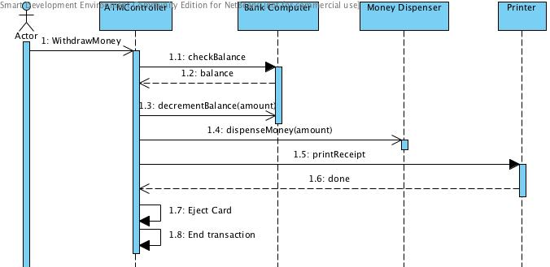
Async Message Example
There are problems here… what are they?
Synchronous message
Asynchronous message
Coming up: Components: Guards
Return message

Slide 13
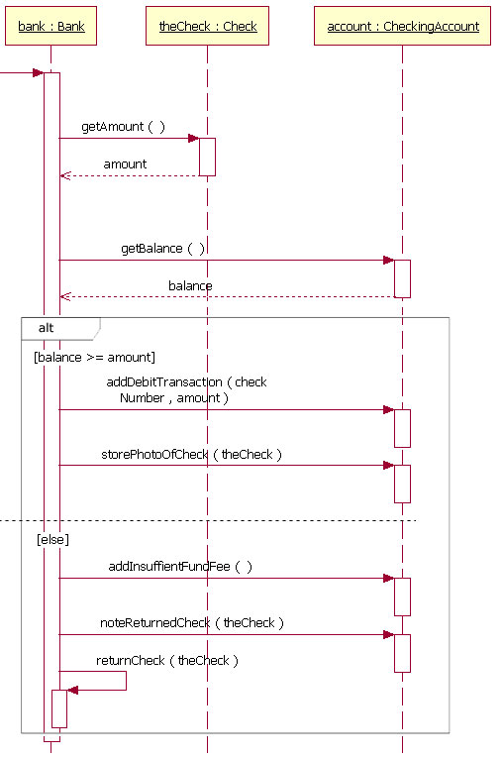
Components: alt/else
Coming up: Components: option

Slide 14
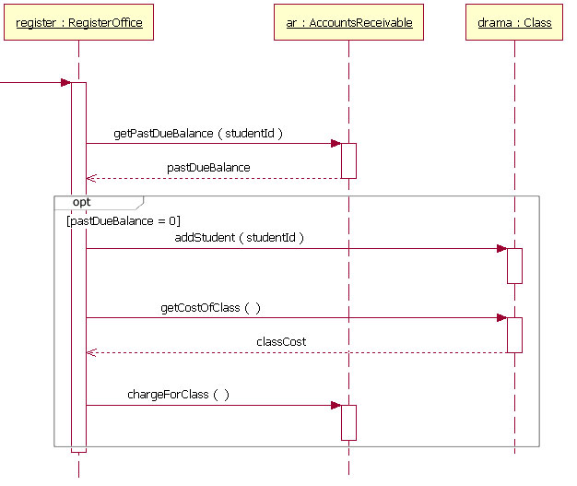
Components: option
Coming up: Components: loop

Slide 15
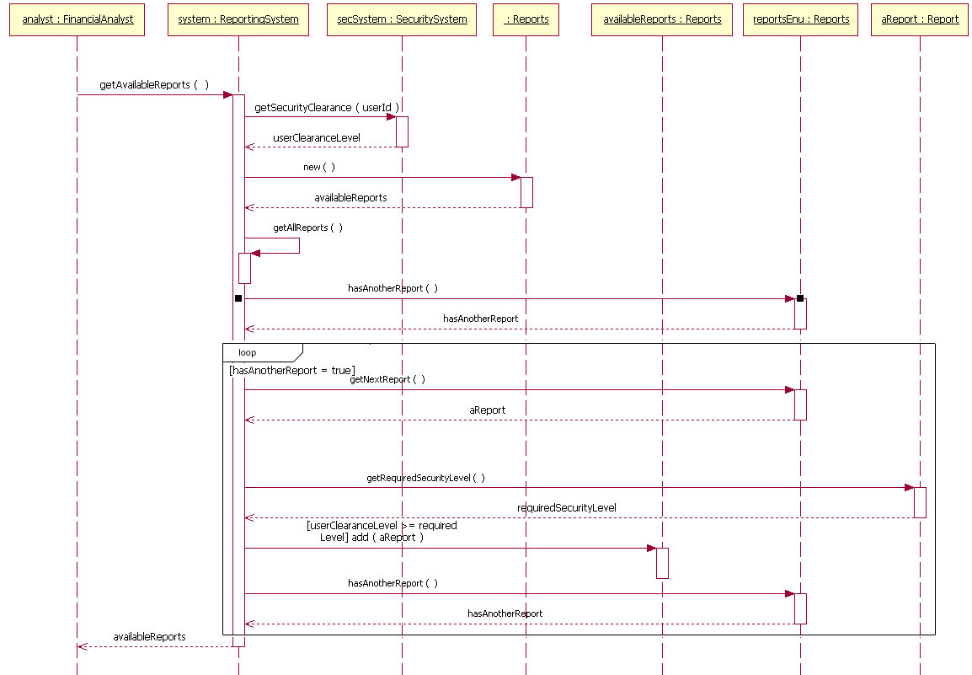
Components: loop
Coming up: In class exercise

